Slide 1
Use Your Noodle!
Sorting with Pasta

Slide 2
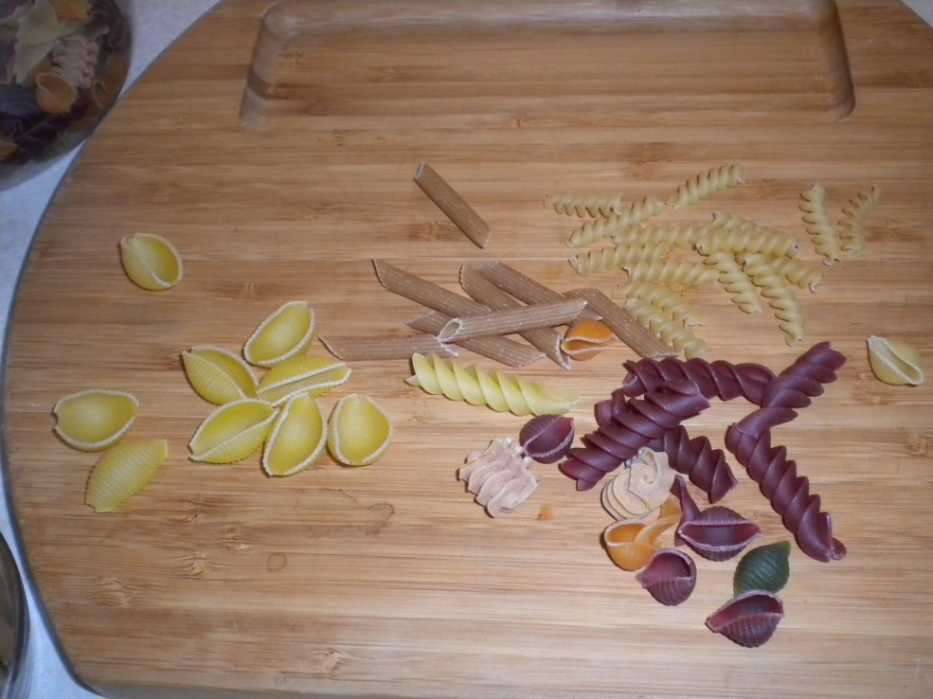
Classification
Classification is important.
Let’s classify some pasta!
We classify many things in many fields: animals vs. plants, positive vs. negative numbers, poetry vs. prose.
There are many different ways to classify the same items.
We have to figure out the best way in each case.

Slide 3
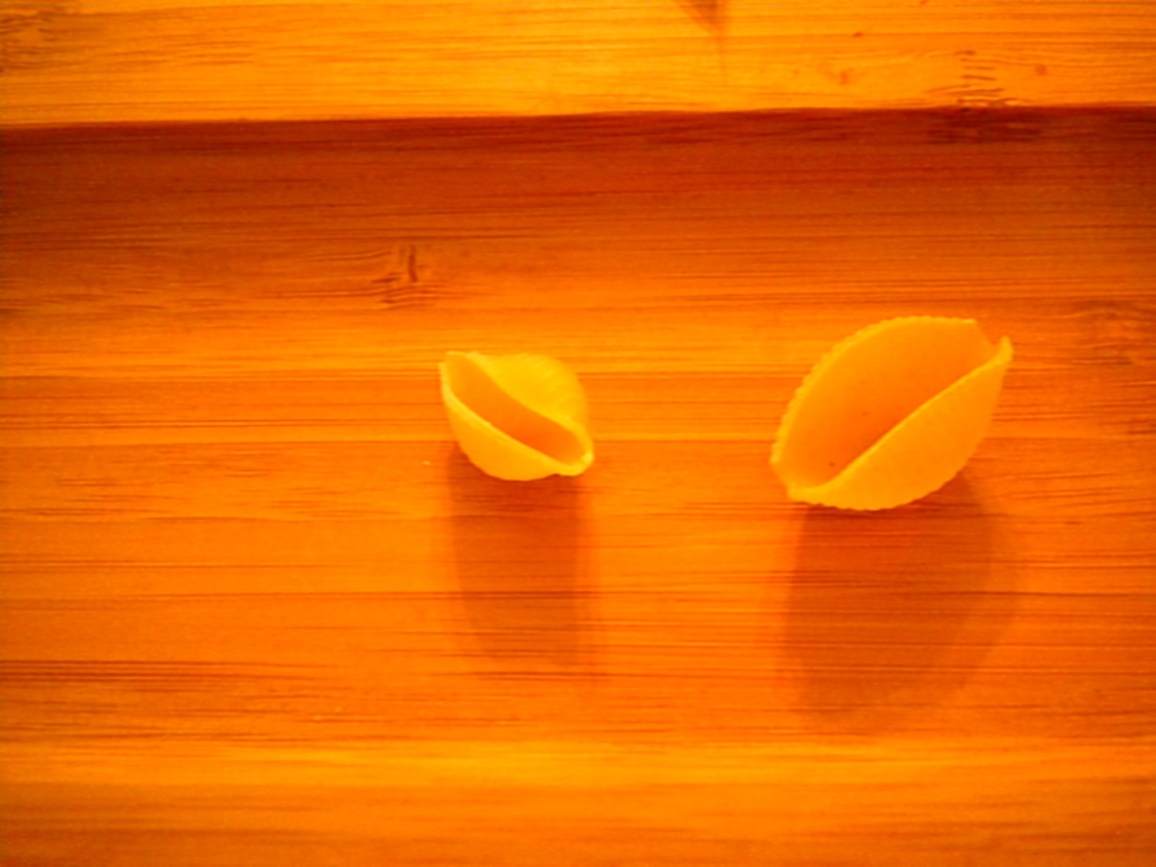
Classify by size: big and small.

Slide 4
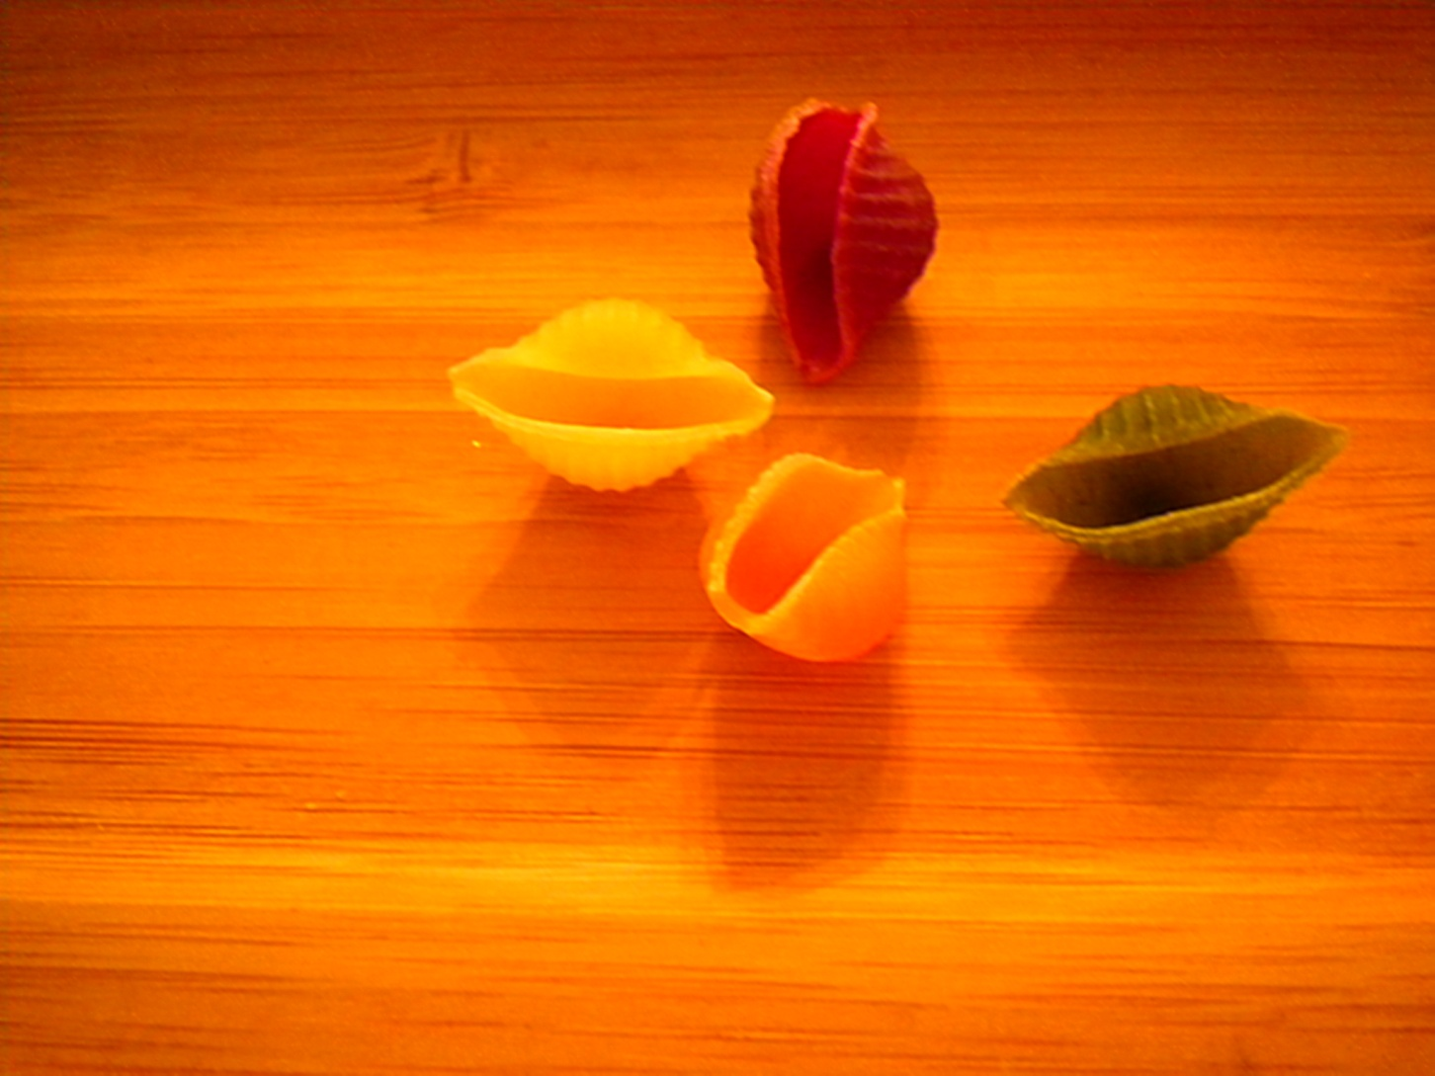
Classify by color: red, green, yellow, orange.

Slide 5
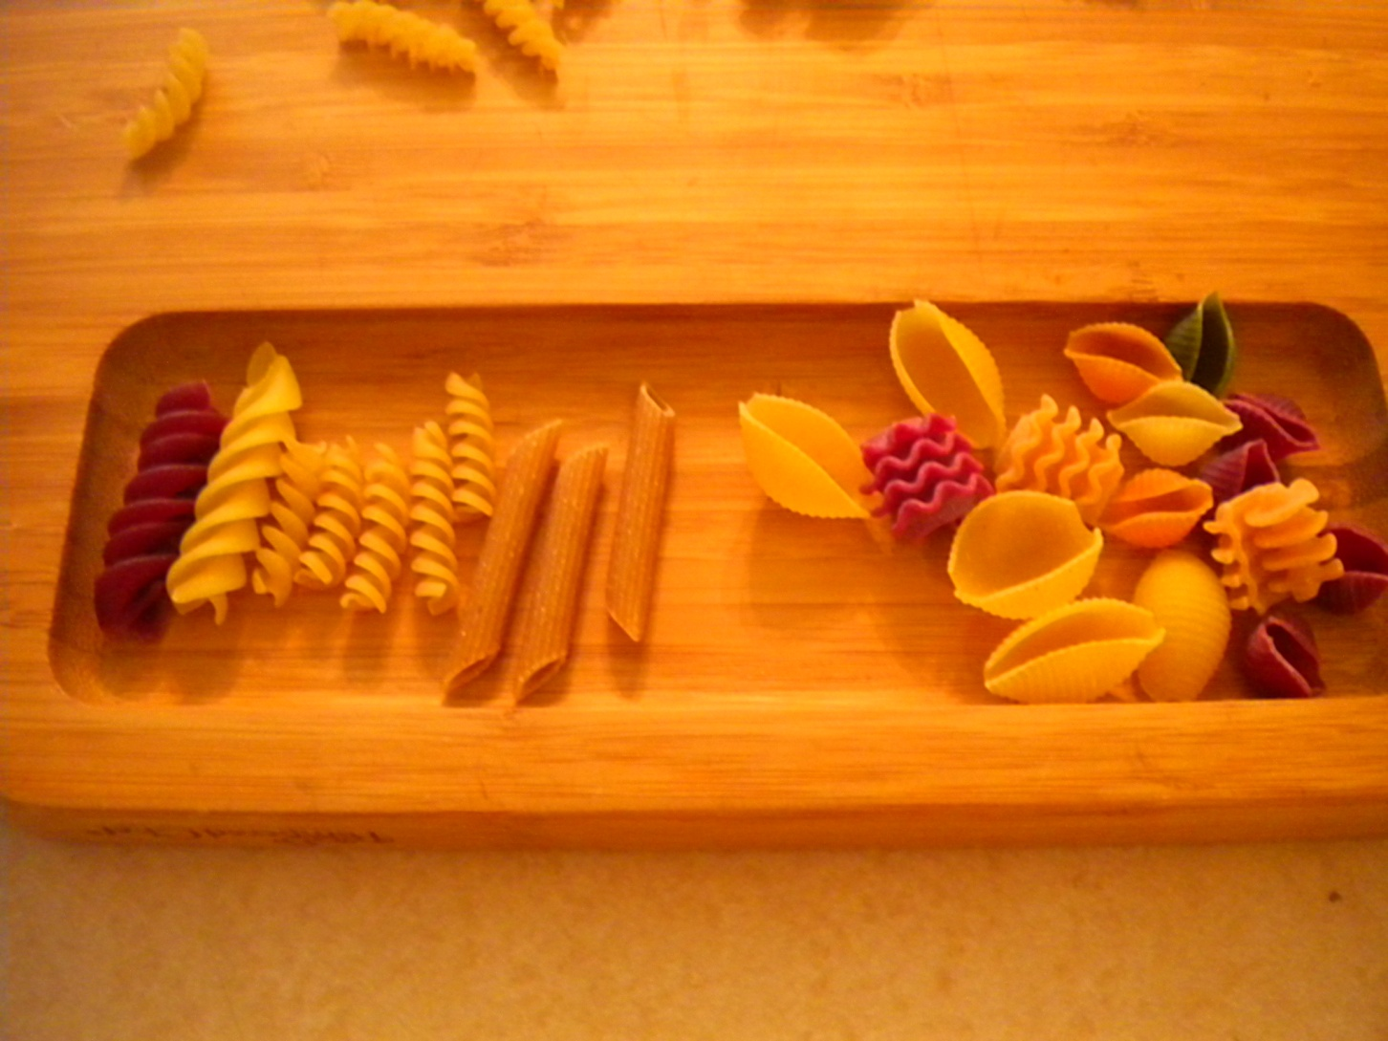
Classify by shape: straight or rounded

Slide 6
There are more possibilities.
So far, we’ve used simple physical characteristics.
Sometimes we need to consider more complex characteristics.
Sometimes we use characteristics of populations, instead of individuals.

Slide 7
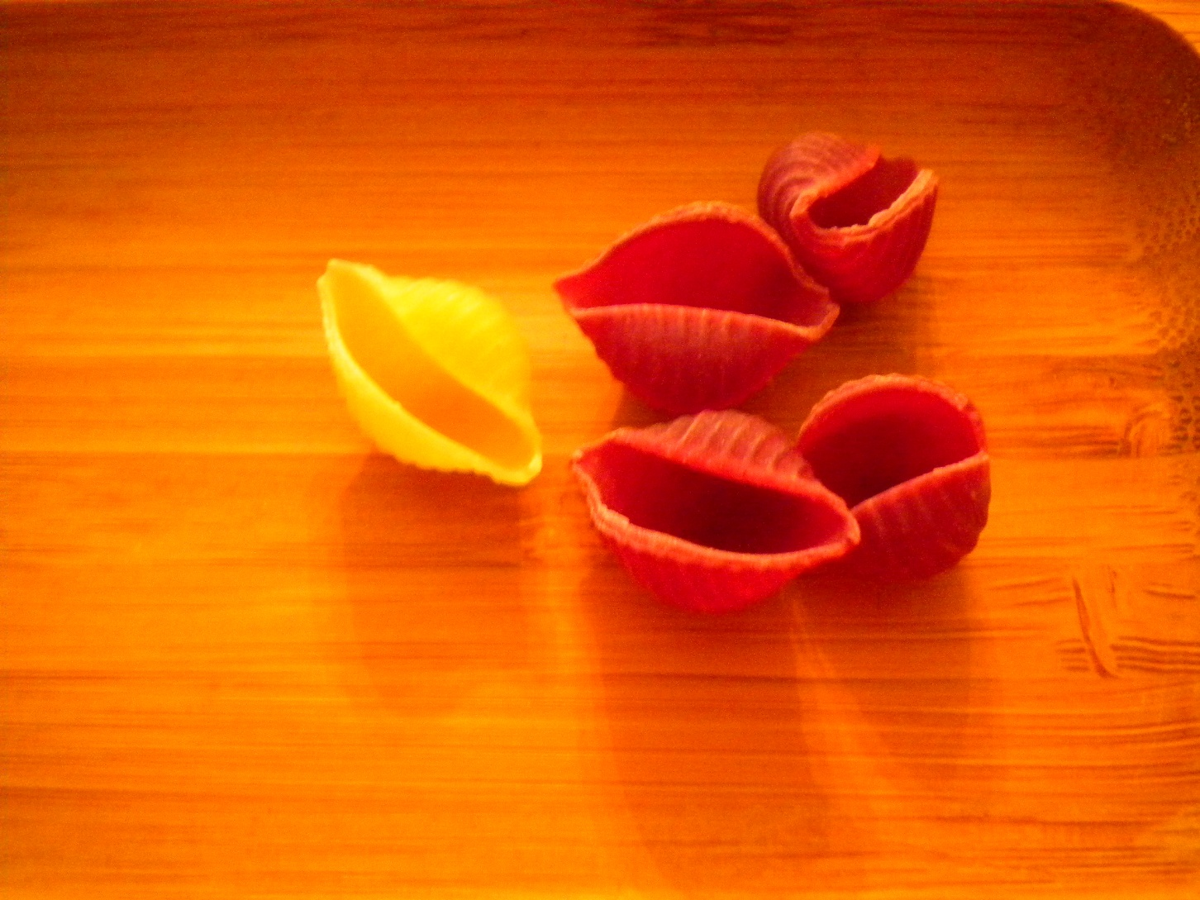
One item vs. many items.

Slide 8
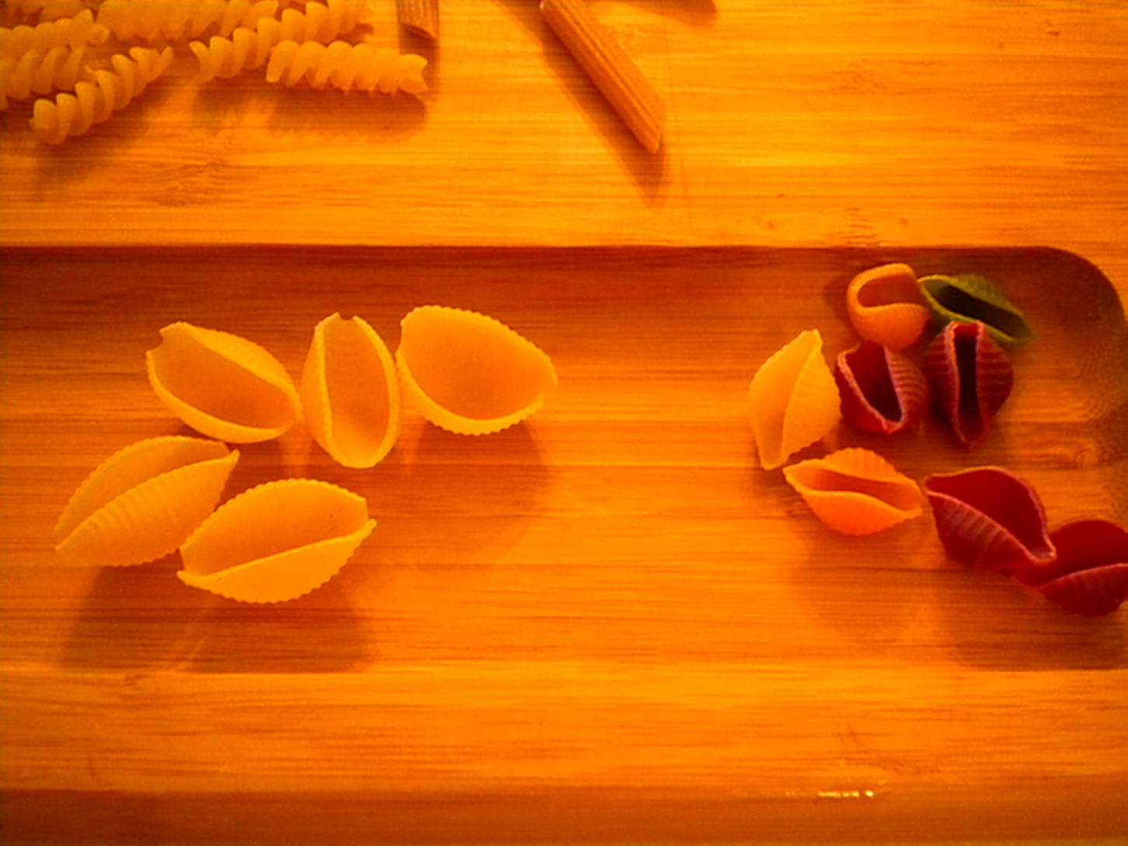
Uniform vs. varied

Slide 9
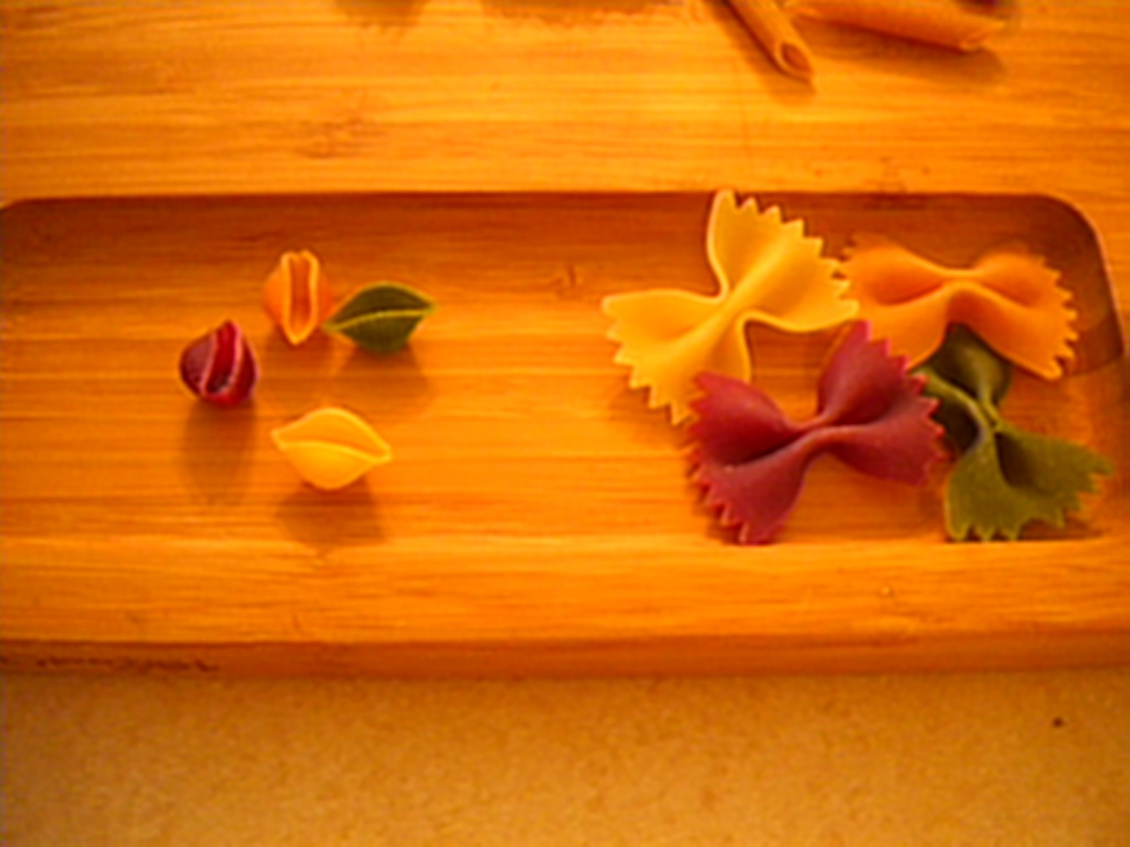
Sometimes there are multiple variables: more than one difference.

Slide 10
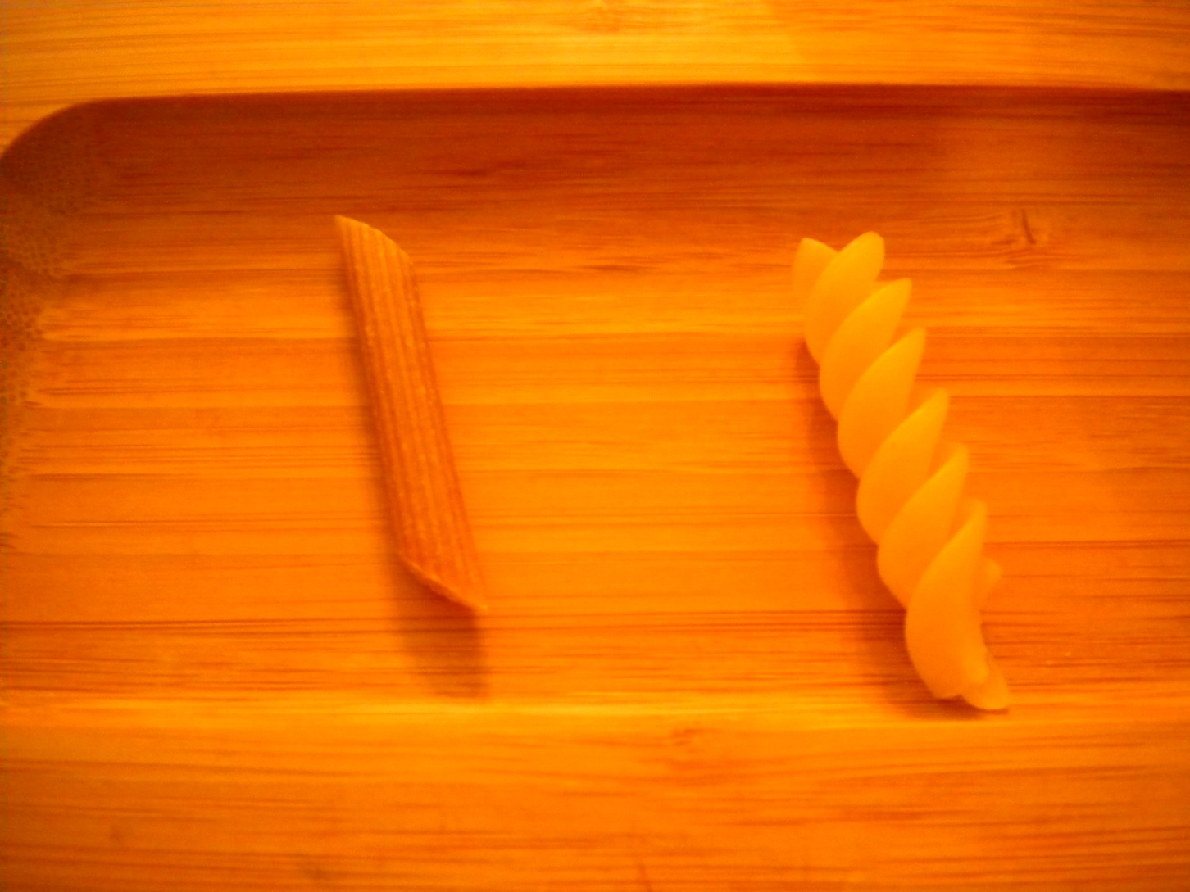
Straight vs. curly

Slide 11
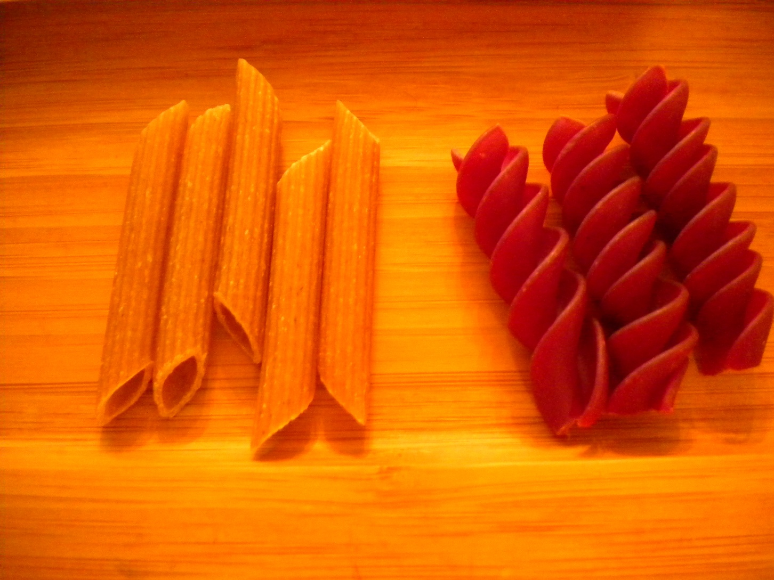
Straight and yellow vs. curly and red

Slide 12
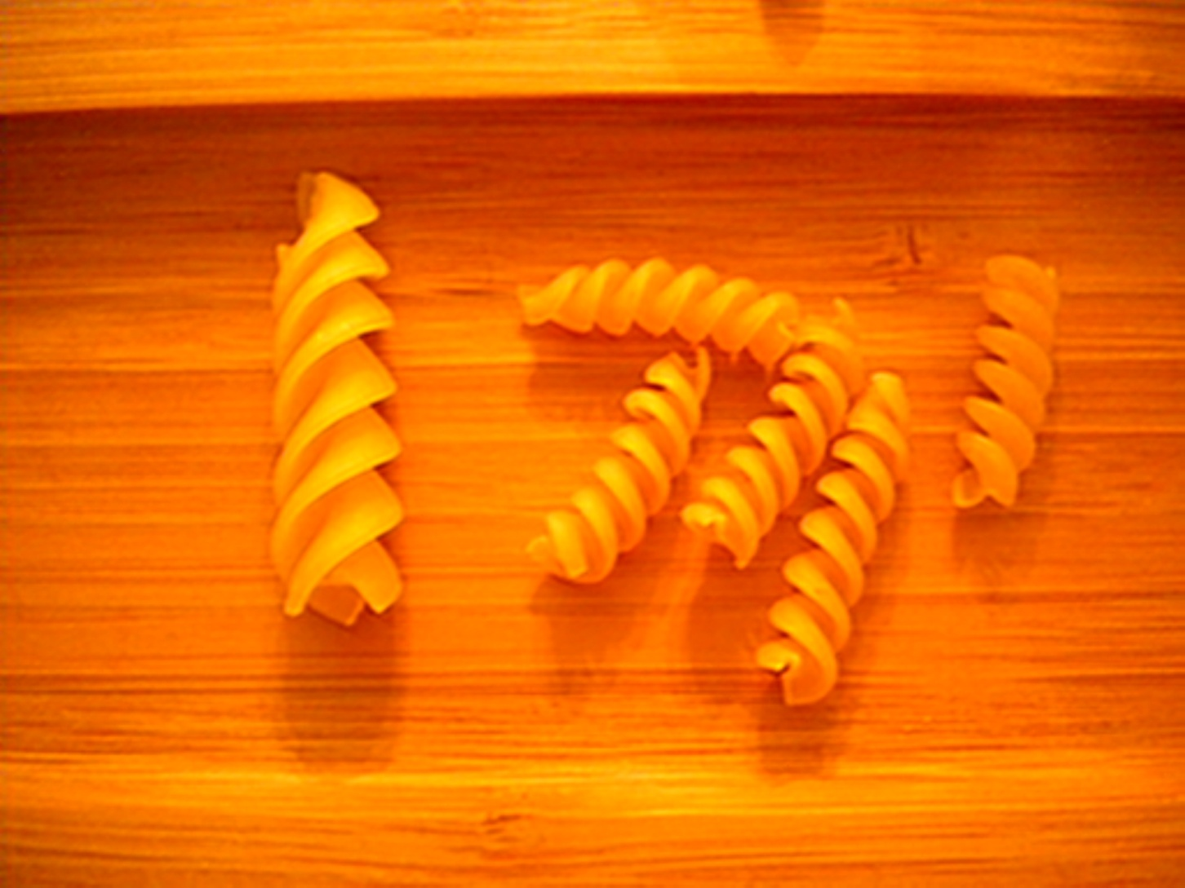
Same shape, different size and quantity

Slide 13
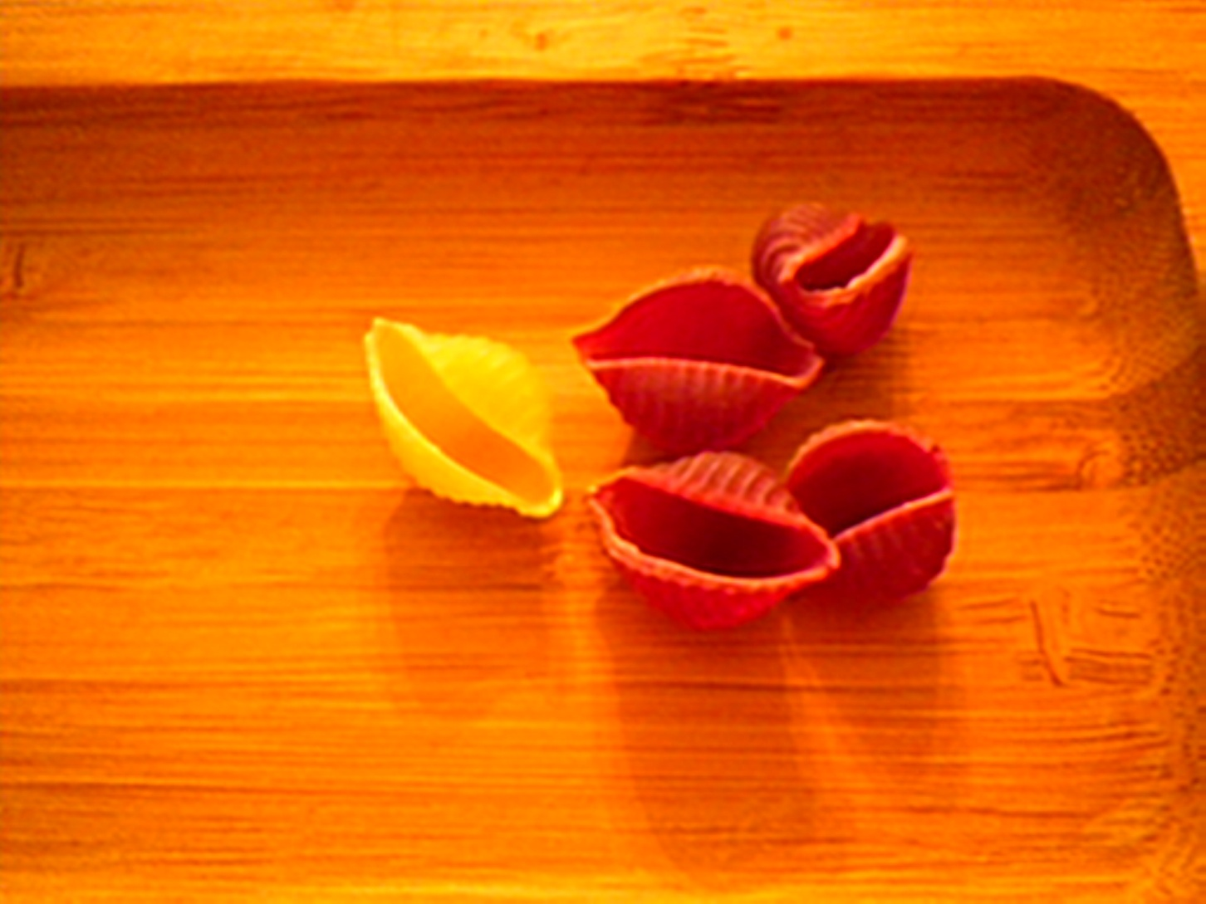
Same shape and size, different colors

Slide 14
Same shape and color, different size

Slide 15
Sometimes we can ignore some variables and focus on others.

Slide 16
Straight vs. rounded

Slide 17
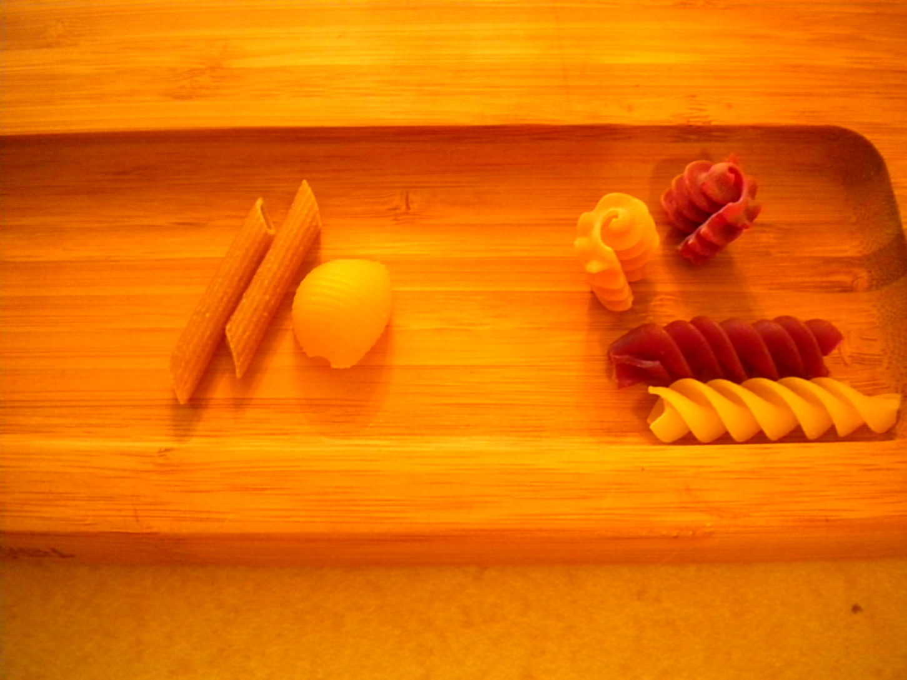
Ridges vs. spirals

Slide 18
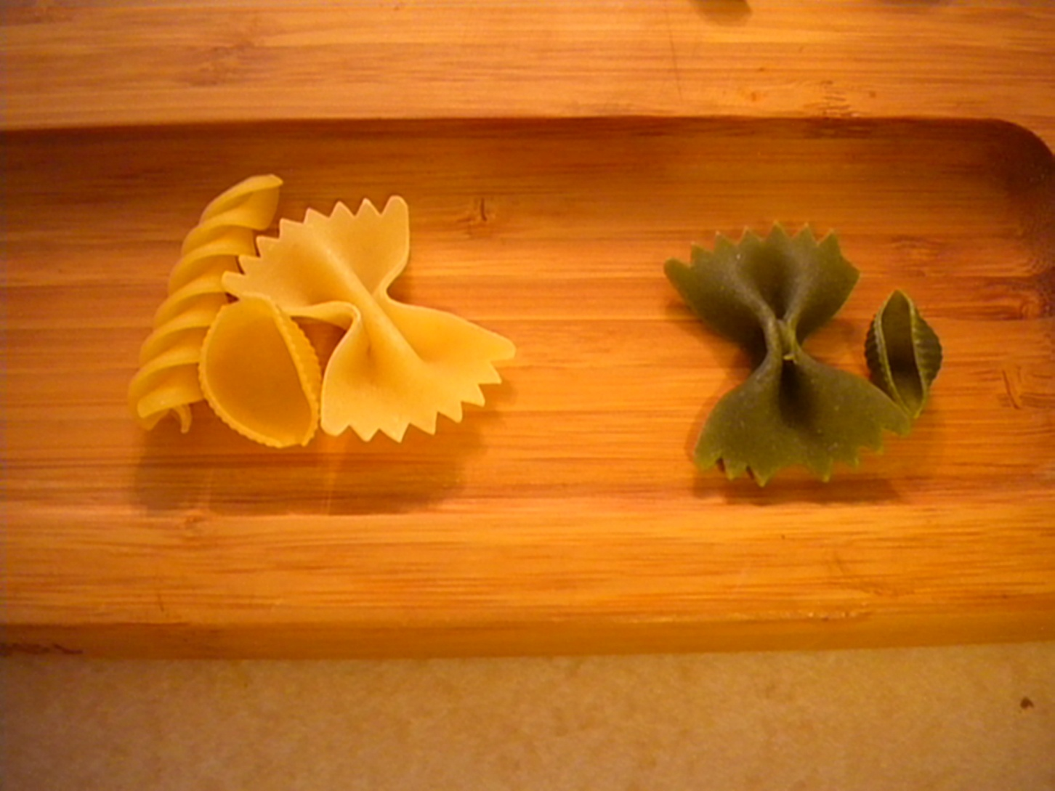
Yellow vs. green

Slide 19
Classification can be a first step.
Sometimes we classify things before we study them to understand them better.
Sometimes we classify things to organize our writing or other presentation.
Sometimes we classify things to make relationships among them more clear.

Slide 20
Classification can be our goal.
Organizing data makes it useful.
Classification can be difficult enough to make it a separate project from other study or work.
In the process of classification, we can discover important concepts.

Slide 21
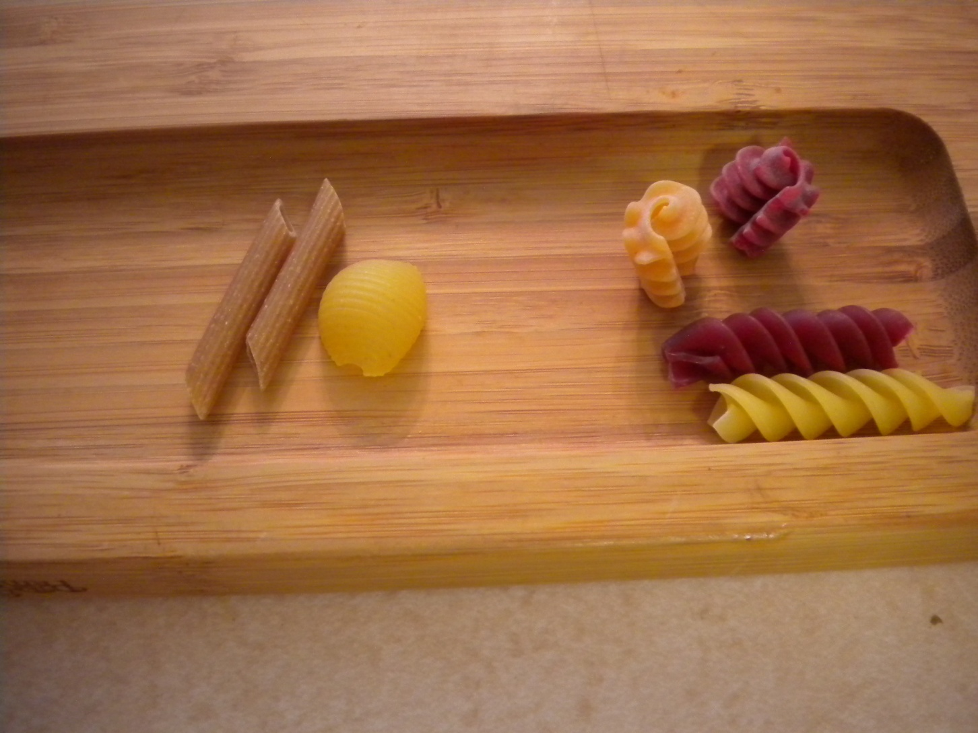
Get it sorted!

Slide 22

www.myfreshplans.com

